Slide 1
Human Evaluation Survey
Harry Fran skidmore

Slide 2
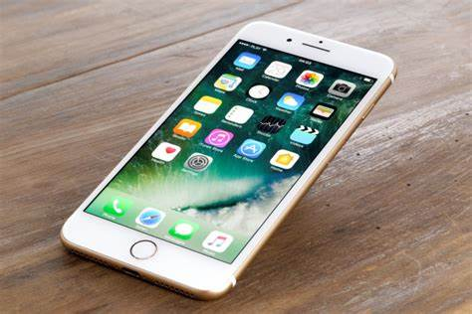
Research Question and Interests
Why do people buy iPhones?
iPhones are expensive, between $600 to $1000
Android and other models of phones do the same basic functions and cost less.
iPhones tend to have a short lifespan.
Yet Apple is still successful and many people buy iPhones.

Slide 3
Participants
15 total participants.
Age, gender, and names unknown
All participants were members of the IDS6267

Slide 4
Technology Acceptance Model
Tool was designed to measure the appreciation and how people interact with and use technology systems. (Venkatseh and Bala 2008).
For this study the tool was adapted to use for this study by changing the words systems to iPhone, as well as adding, changing, and rephrasing some questions.
These changes are a limitation in the study.
Another limitation is the TA is more aimed at a work setting rather then the general opinion of a product.

Slide 5
Qualtrics
Survey site that allows surveys to be built and data analyzed on the site.
Some issues with the site caused some surveys to have to be disgarded.

Slide 6
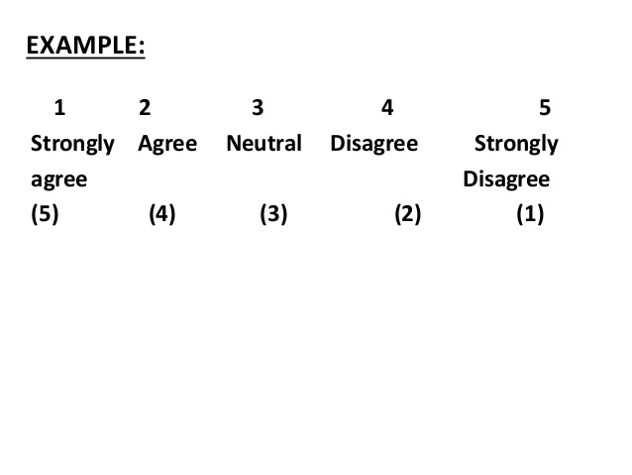
Analysis that was conducted
A likert scale was used for ratings to each question.
The questions were analyzed by looking at the responses and seeing if there were similar responses. There were no use of any statistical tests due to likert scale being susceptible to bias.

Slide 7
Results
10 participants own an iPhone.
The questions seemed to suggest majority had positive interactions with the iPhone, felt it was easy to use, and were satisfied with it. Yet they did not report it to be useful in work places, and responses suggested that others influenced them to have one but this is not clear.

Slide 8
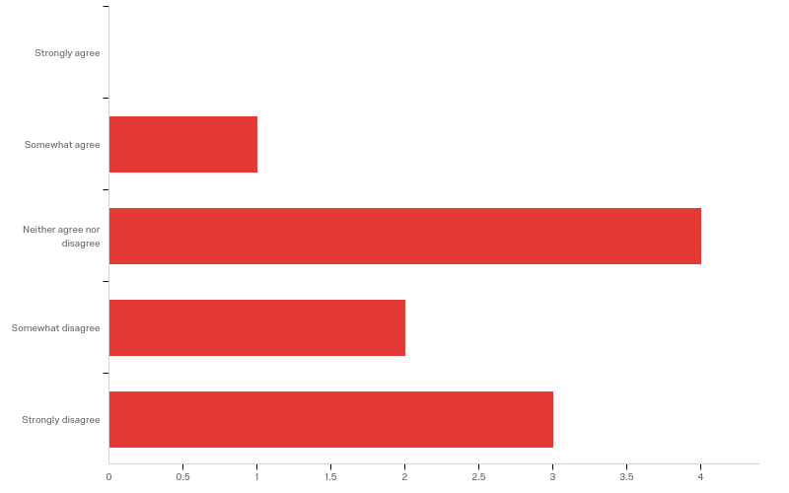
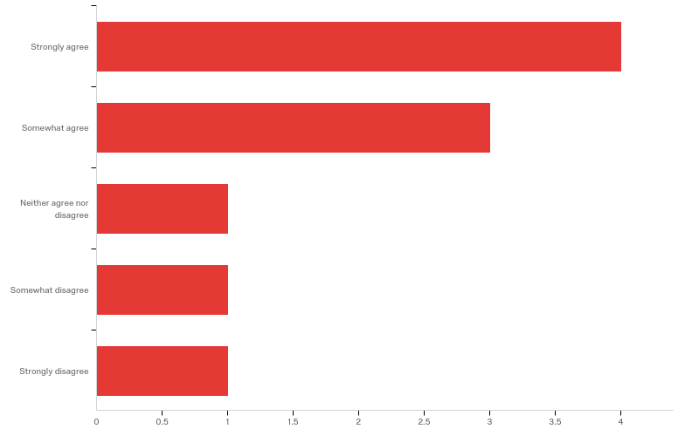
Graphs of data Continued
Q32 - In my job usage of the iPhone is important
Q37 - I rate the results from the iPhone to be excellent(I am satisfied with the iPhone)

Slide 9
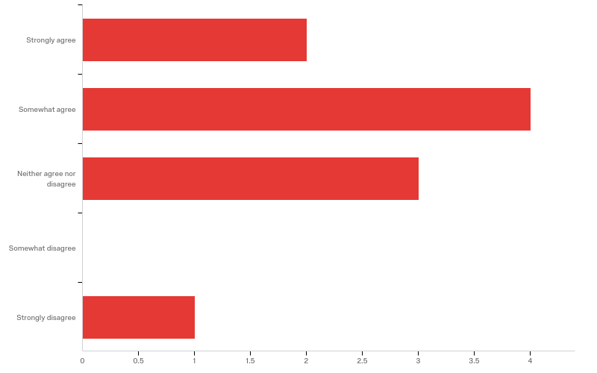
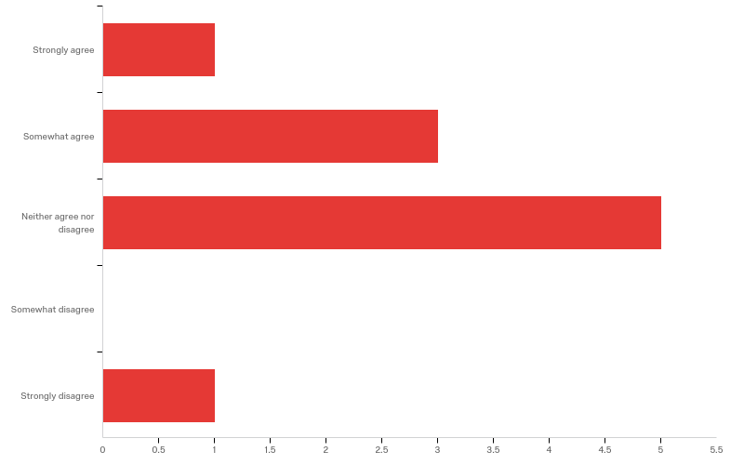
Graphs of data Continued
Q25 - People who are important to me think I should use an iPhone.
Q24 - People who influence my behavior think that I should use the iPhone

Slide 10
Results Those who do not have an iPhone
5 participants do not currently have one and have never had one.
Most questions were met with “neither agree or disagree” responses.

Slide 11
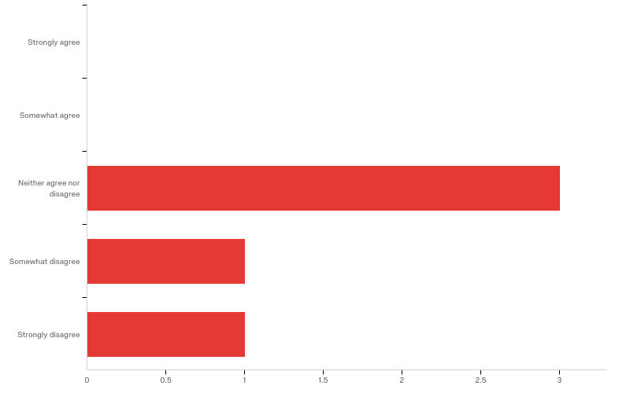
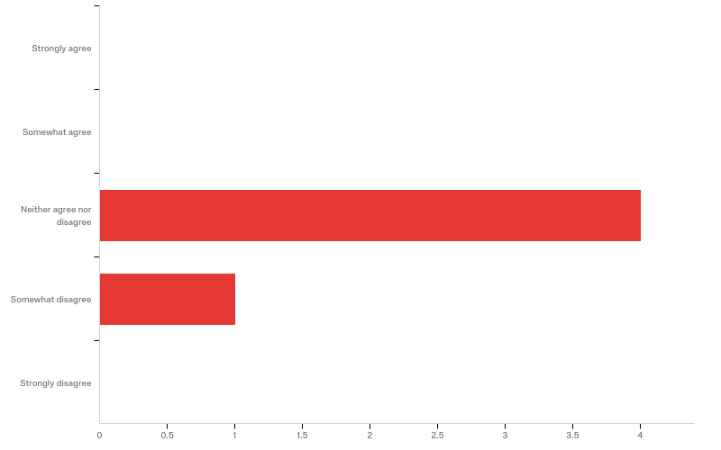
Results
Q14 - Given the resources, opportunities and knowledge it takes to use the iPhone, it would be easy for me to use the iPhone.
Q36 - I have no problem with the quality of the iPhone performance and abilities

Slide 12
Discussion
The survey may not have been the best tool to use.
The participants that have a iPhone felt mostly positive feelings and reported mostly positive experiences with them. This could be why they buy them despite the previous mentioned criticism. A more in depth future study would be needed for further elaboration on issues such as what they get that is satisfying, as well as to elaborate on what jobs they have and who they feel is influencing them, or why they feel they are not influenced.
There did seem to be a lack of desire to use the iPhone in non iPhone users. This could be explored in the future with studies to examine this possibility.
The only similarities between the iPhone owners and non owners was the lack of using it at work.

Slide 13
References
Venkatesh, V., Bala H. (2008) Technology acceptance model 3 and a research agenda on interventions. Decision Sciences 39 273-315

